Slide 1
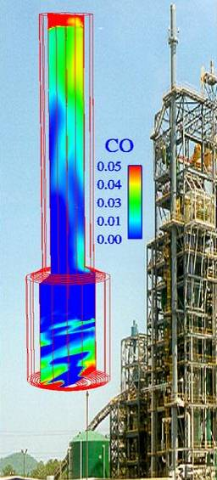
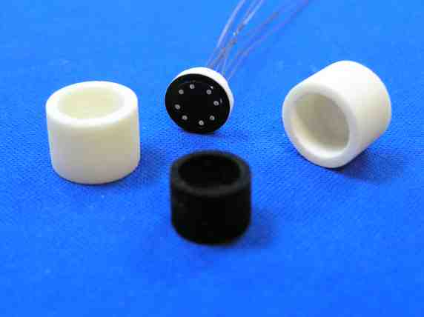

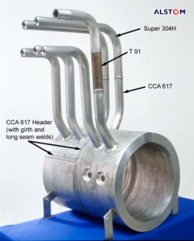
Seminar on NETL’s Minority Serving Institutions Program
Doing Business with the Federal Government
Nicole Murray
Contract Specialist
Finance & Acquisition Center
November 9, 2016
Notes:
Thank you so much for attending today’s presentation. My name is Nicole and I manage a lot of the funding opportunity announcements for our university programs, specifically our minority serving institutions programs. Today my objective is to educate you on what a funding opportunity announcement is, and how to apply for one.

Slide 2
Steps to Apply for NETL Grant
Identify opportunity of interest through Funding Opportunity Announcement (FOA)
  Discussed in detail later in presentation
Meet registration requirements
Prepare and Submit Application
Notes:
In addition to learning a little bit about what a funding opportunity is, I will also be talking about registration requirements, as well as how to prepare and submit your application on the required websites. So to begin, there are generally three phases of showing and acting on your interest to a Federal funding opportunity announcement: (1) You identify the opportunity on one of the websites that I will be showing you, (2) You check the opportunity to make sure that you are registered at all of the required websites, and (3) You then prepare and submit your application information.

Slide 3
Funding Opportunity Announcement (FOA)
A publicly available document by which a Federal agency makes known its intentions to award discretionary grants or cooperative agreements, usually as a result of competition for funds.
  May be known as program announcements, requests for applications, notices of funding availability, solicitations, or other names depending on the agency and type of program.
Notes:
To begin: What is a funding opportunity announcement? A funding opportunity announcement, also known as an FOA, is a publically available document by which a Federal agency makes known its intentions to award discretionary grants or cooperative agreements, usually as a result of competition for funds. As you will see on the slide, these same announcements may go by other names in other agencies; however, with the Department of Energy and specifically the National Energy Technology Laboratory, we will refer to them as FOAs.

Slide 4
Registration/Submission Requirements
Obtain a Dun and Bradstreet Data Universal Numbering System (DUNS) number (www.dnb.com/duns-number.html)
Register with the System for Award Management (SAM) (www.sam.gov)
Register with Grants.gov
Register with Fedconnect.net
Notes:
As previously mentioned, there are a few websites that you will need to register with prior to application for any funding opportunity announcement. Without proper registration you may be unable to submit your application documents, access key documents, or continue on to the selection process.
The first thing you will want to do to prepare to do business with the Federal government is to obtain a Dun and Bradstreet Data Universal Systems number – also known as a DUNS number. The DUNS number is a nine-digit identification number for each physical location of your business, is free for all businesses, and is required to register with the Federal government for contracts or grants. If you access www.dnb.com, you will see on the top of the screen it says D-U-N-S Number. Clicking there will direct you to the area where you can obtain a DUNS number for your business.
The second website you will have to register with is the System for Award Management, or SAM. SAM is an official website of the U.S. government, and is where you will register to do business with the government.
The remaining two websites, Grants.gov and Fedconnect.net, will be explained on the next two slides

Slide 5
Registration Requirements: Grants.gov
Register with Grants.gov
  There are 3 steps to this process:
    (1) The Authorized Organizational Representative (AOR) must register
    (2) An email is sent to the E-Business (E-Biz) POC listed in SAM. The E-Biz POC must approve the AOR registration using their MPIN from their SAM registration.
    (3) AOR verifies that registration was completed at Grants.gov
    Grants.gov is where you will submit your application package.
Notes:
Grants.gov is the public website where all federal financial opportunities will be listed, and you are required to register with the website in order to view or apply for opportunities. There are 3 steps to this process: Step 1: The Authorized Organization Representative must register with the site. Step 2: An email is then sent to the E-Business (or E-Biz) point of contact listed in SAM. The E-Biz point of contact must approve the registration using their MPIN from their SAM registration. Step 3: the AOR verifying that registration was completed back on Grants.gov

Slide 6
Registration Requirements: Fedconnect
Applicants must register with FedConnect to submit questions. FedConnect website: www.fedconnect.net.
View and download announcement documents or amendments
Correspond with Federal representatives managing that announcement
Please allow at least 44 days to complete this entire registration process.
Notes:
The final area where a registration is required is on FedConnect. Like Grants.gov, FedConnect is where you can view, access, and submit questions related to funding opportunity announcements that are currently out for solicitation.
There can sometimes be confusion as to the role of grants.gov vs. fedconnect.net. Grants.gov operates as the Package and Submission portal, where Fedconnect is the Government’s link TO that portal. The Fedconnect allows the Government to communicate with the Applicant regarding questions and answers during the FOA process.
Registration can be a lengthy process, so we recommend at least 44 days to complete the process.

Slide 7
Questions
Questions related to the registration process, system requirements or how an application form works must be directed to Grants.gov at 1-800-518-4726 or support@grants.gov
Questions related to the content of the announcement must be submitted to the FedConnect portal.
  Must be registered with FedConnect to submit questions and view responses
Notes:
If you have any questions about the registration processes, each of the websites have Contact Us buttons where you can submit your questions or contact a live representative who can help you out. If you have questions relating to a specific FOA, those questions must be submitted directly through the FOA itself in the FedConnect portal, and we will go over that a bit later.

Slide 8
Application Preparation and Submission
Applicants must download application package, forms and instructions at http://www.grants.gov/
Applications must be submitted through Grants.gov.
    Must be registered at Grants.gov!
    Update SAM annually
Applications must be submitted through http://www.grants.gov by a qualified HBCU/OMI (Minority Serving Institution) authorized representative.
Notes:
Grants.gov is the portal in which you will submit your actual application to the FOA. Within grants.gov you can download the full application package and any associate forms and instructions. As mentioned previously, you must be registered at Grants.gov in order to do this. Also, when submitting your application package please be sure that it is being submitted by an authorized representative of your institution.

Slide 9
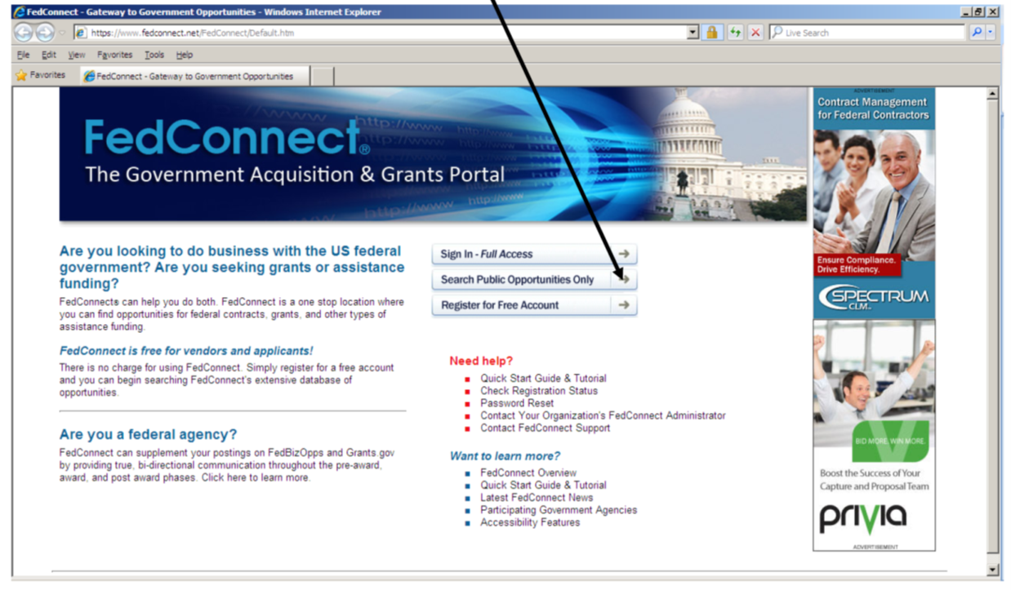
Accessing NETL FOAs in FedConnect
In an internet browser, enter the FedConnect URL www.FedConnect.net
On the Main Page, click on Search Public Opportunities and Awards
Notes:
FedConnect is where you can also search public opportunities. The screenshot on this slide shows you exactly where to click in order to begin your search.

Slide 10
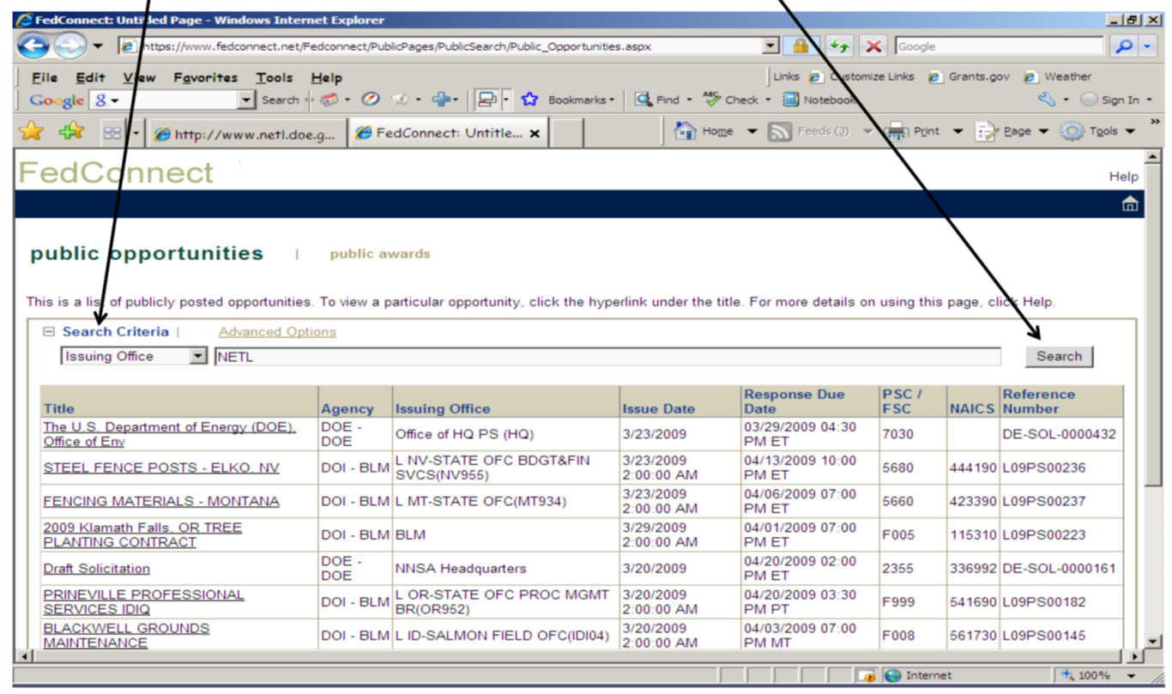
Accessing NETL FOAs in FedConnect
Under Search Criteria, select Issuing Office and type NETL. Click on Search.
Notes:
Once you choose “Issuing Office” from the drop down box, type in “NETL” and hit “Search”. This will bring up all active solicitations for NETL. You can view active solicitations for other agencies as well by changing the search criteria to reflect whichever agency you may be interested in.

Slide 11
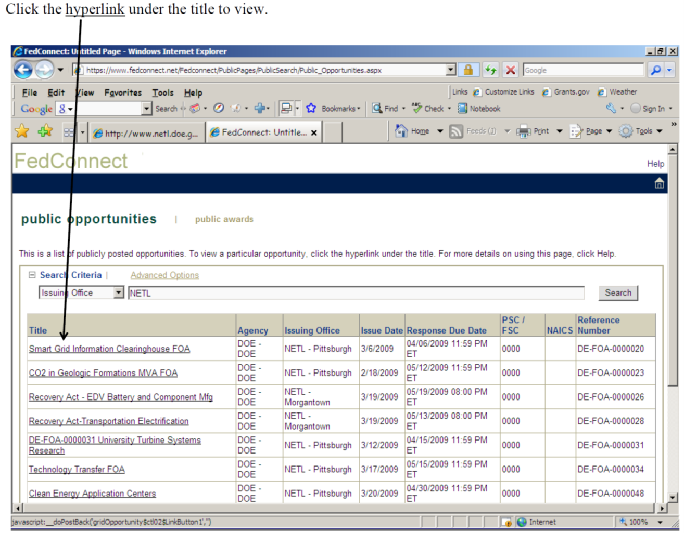
Accessing NETL FOAs in FedConnect
Click the hyperlink under the title to view.
Notes:
Once you locate the announcement that you are interested in, simply click on the hyperlink under the title to view the announcement.

Slide 12
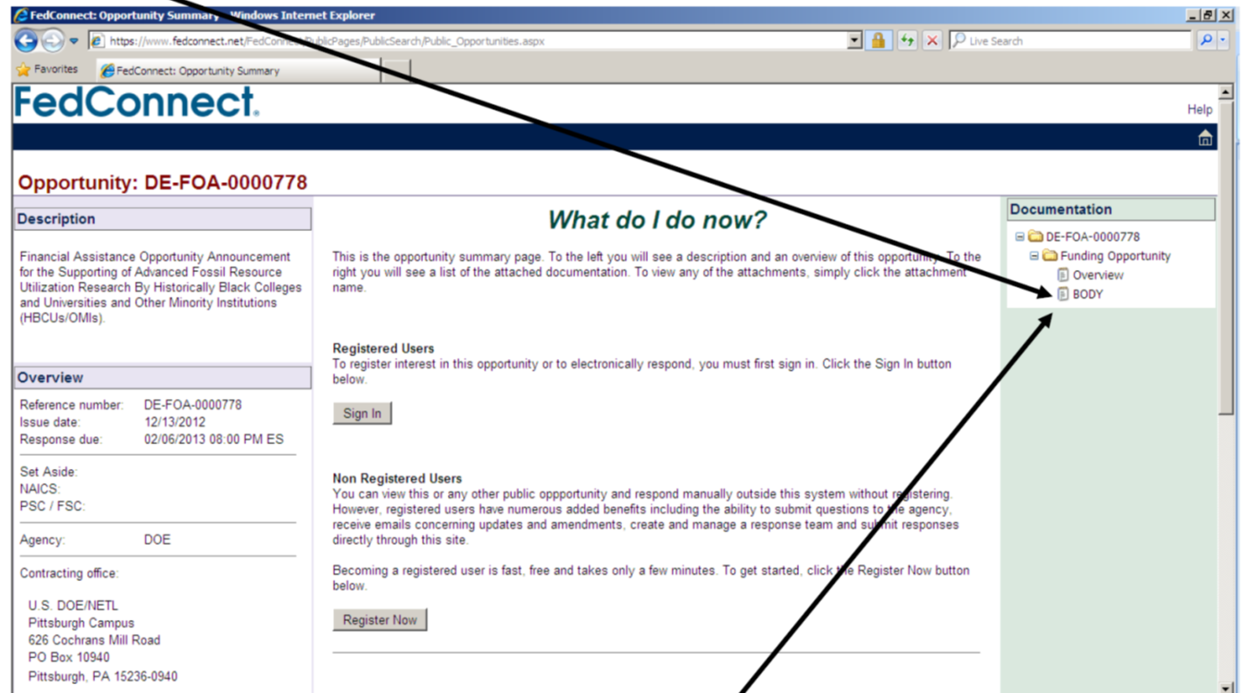
Accessing NETL FOAs in FedConnect
Click on Body under Solicitation to view the FOA instructions
To view Amendments to the FOA, click on Body below original posting
Notes:
This is where a lot of people get confused. On the left hand side of the screen, you will find basic information pertaining to the announcement: a description, an overview of due dates, agency information, etc. It is on the right hand side where you will actually find the announcement itself. The announcement is not titled “FOA”, rather it is titled “Body”. By clicking on “Body” you will access the entire funding opportunity announcement which will go into full detail about what is being solicited, available funding, eligible applicants, required forms, etc.

Slide 13
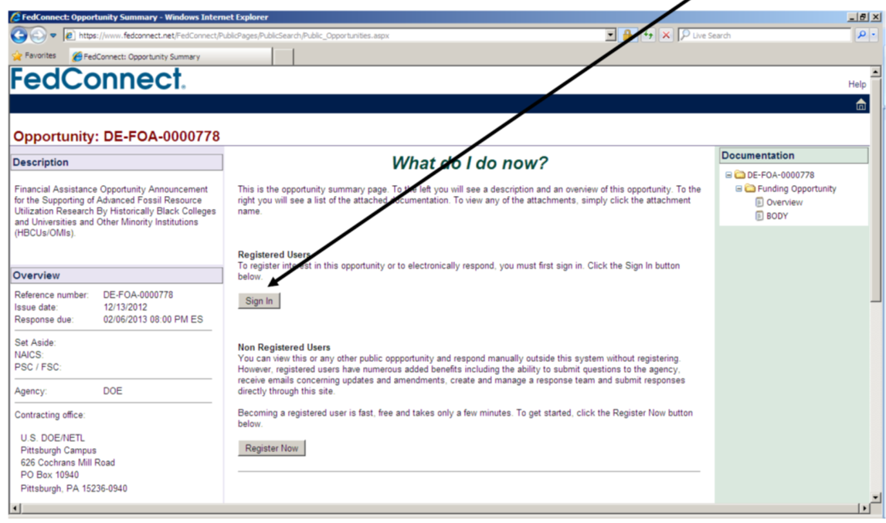
Accessing NETL FOAs in FedConnect
To submit questions about this FOA or submit an application, Registered Users click on Sign In.
Notes:
If you are accessing the FOA information looking to submit questions, you must sign in to FedConnect in order to do so. FedConnect will automatically send the e-mail to the FOA point of contact who will respond to the question usually within 3 business days.

Slide 14
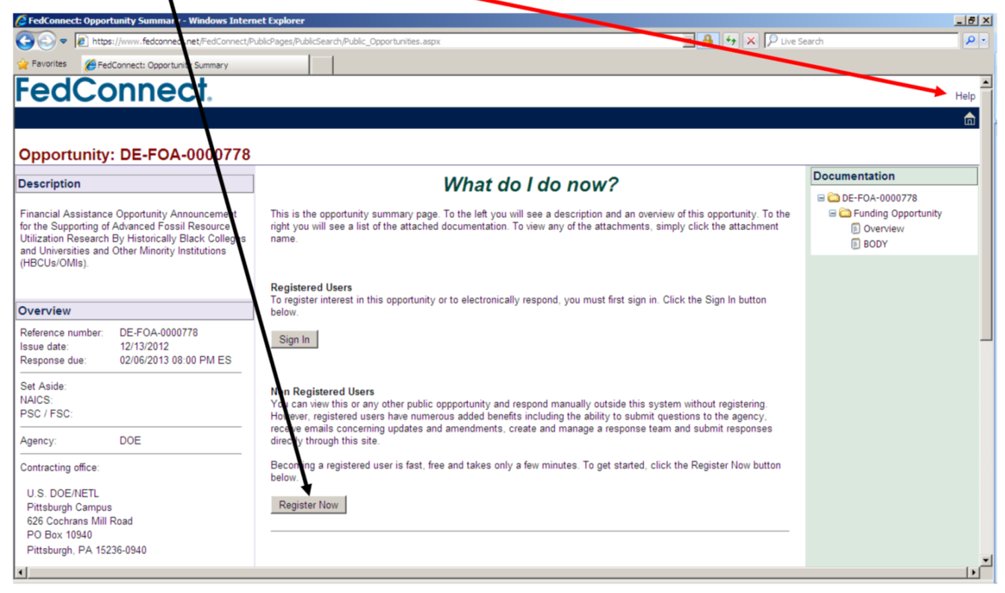
Accessing NETL FOAs in FedConnect
Click on Register to Receive Notifications to receive agency alerts and view the message center.
      Help buttons are available on each page to assist you with functions of FedConnect.
Notes:
You can also register within FedConnect to review notifications pertaining to any opportunity that you are interested in by clicking Register Now on the front screen of the opportunity. In addition, help buttons are provided should you run into any questions during the process.

Slide 15
Opportunities for Work with NETL
NETL Research Programs use the following sites
to post solicitations/funding opportunity announcements, receive proposals/applications, and disseminate other information for competitive awards. Entities wishing to participate in these solicitations will need to register at these websites.
  Fedconnect https://www.fedconnect.net/FedConnect/
  Grants.gov http://grants.gov/
  FedBizOpps https://www.fbo.gov/
Proposals will be accepted only through FedConnect or Grants.gov and will be indicated in the solicitation document. Each website has the ability to send email messages when a new solicitation is posted from NETL.
Additional information can also be found at the NETL Business website:http://www.netl.doe.gov/business/
Notes:
Questions?

